Slide 1
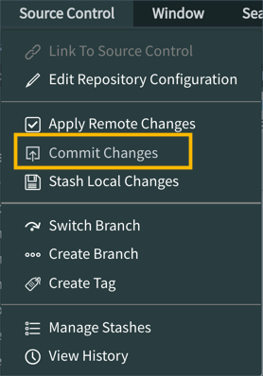
Exercise: Save Your Create the NeedIt Application Work
Source control applications, like GitHub, allow developers to commit changes (save completed work) outside of the Personal Developer Instance (PDI). Commit changes made to the application to save your work in source control.
In this exercise, you will save the work completed in this module to your GitHub repository.
If the NeedIt application is not open in Studio, open it now.
In the main ServiceNow browser window, use the All menu to open System Applications > Studio.
In the Select Application dialog, click the application - needit.
Open the Source Control menu and select the Commit Changes menu item.

Slide 2
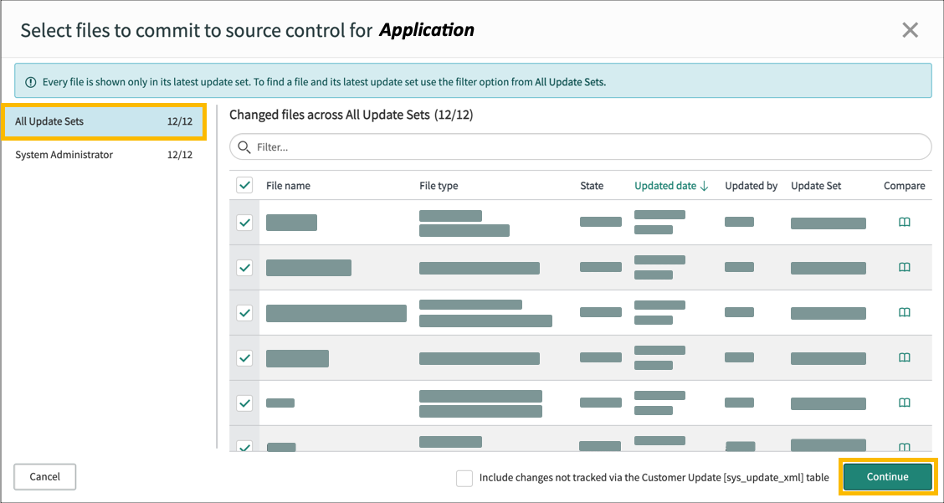
Exercise: Save Your Create the NeedIt Application Work
Select the updates to commit.
In the Select files to commit to source control for <Application> dialog, select All Update Sets.
Review the application files to be committed.
Click the Continue button.

Slide 3
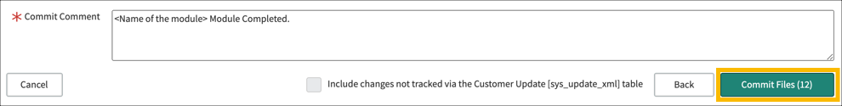
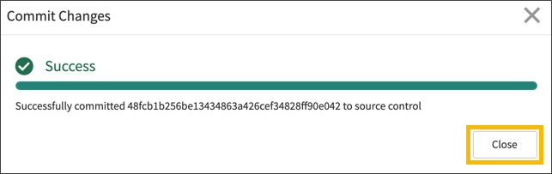
Exercise: Save Your Create the NeedIt Application Work
In the Confirm files to commit to source control for NeedIt dialog, enter a Commit comment, such as Create the NeedIt Application Module Completed.
Click the Commit Files button.
When the Commit Changes dialog reports success, click the Close button.

